Slide 1
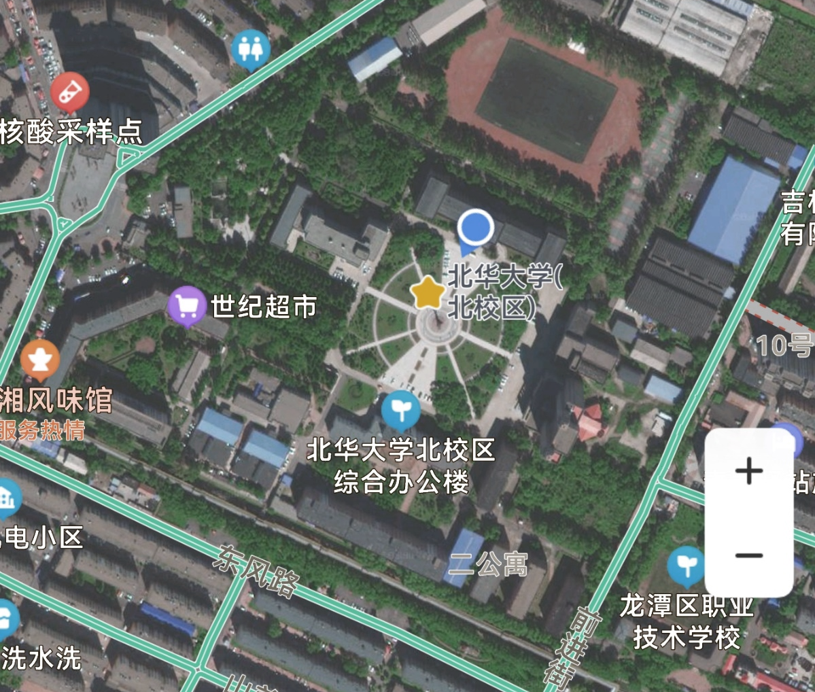
操场
门
二教
一教
九
七
三教
一食堂
教工
二食堂
三

Slide 2
无向有权图
序号(代号) | 节点名称
1 | 门
2 | 二教
3 | 操场
4 | 一教
5 | 三教
6 | 教工
7 | 一食堂
8 | 二食堂
9 | 三
10 | 七
11 | 九
操场
60
40
门
二教
一教
40
30
50
九
80
70
20
50
七
60
三教
一食堂
15
教工
10
10
二食堂
10
70
三

Slide 3
无向等权可达图
序号(代号) | 节点名称
1 | 门
2 | 二教
3 | 操场
4 | 一教
5 | 三教
6 | 教工
7 | 一食堂
8 | 二食堂
9 | 三
10 | 七
11 | 九
操场
1
1
门
二教
一教
1
1
1
九
1
1
1
1
七
三教
1
教工
一食堂
1
1
1
二食堂
1
1
三

Slide 4
权值邻接矩阵 | 门 | 二教 | 操场 | 一教 | 三教 | 教工 | 一食堂 | 二食堂 | 三 | 七 | 九
门 | 0 | 40 | -1 | -1 | -1 | -1 | -1 | -1 | -1 | -1 | 30
二教 | 40 | 0 | 60 | -1 | -1 | 70 | -1 | -1 | -1 | -1 | 50
操场 | -1 | 60 | 0 | 40 | -1 | -1 | -1 | -1 | -1 | -1 | -1
一教 | -1 | -1 | 40 | 0 | 50 | 80 | -1 | -1 | -1 | -1 | -1
三教 | -1 | -1 | -1 | 50 | 0 | -1 | -1 | -1 | 10 | -1 | -1
教工 | -1 | 70 | -1 | 80 | -1 | 0 | 15 | 10 | -1 | -1 | -1
一食堂 | -1 | -1 | -1 | -1 | -1 | 15 | 0 | 10 | -1 | 60 | -1
二食堂 | -1 | -1 | -1 | -1 | -1 | 10 | 10 | 0 | 70 | -1 | -1
三 | -1 | -1 | -1 | -1 | 10 | -1 | -1 | 70 | 0 | -1 | -1
七 | -1 | -1 | -1 | -1 | -1 | -1 | 60 | -1 | -1 | 0 | 20
九 | 30 | 50 | -1 | -1 | -1 | -1 | -1 | -1 | -1 | 20 | 0

Slide 5
邻接矩阵
 | 门 | 二教 | 操场 | 一教 | 三教 | 教工 | 一食堂 | 二食堂 | 三 | 七 | 九
门 | 0 | 40 | 8888 | 8888 | 8888 | 8888 | 8888 | 8888 | 8888 | 8888 | 30
二教 | 40 | 0 | 60 | 8888 | 8888 | 70 | 8888 | 8888 | 8888 | 8888 | 50
操场 | 8888 | 60 | 0 | 40 | 8888 | 8888 | 8888 | 8888 | 8888 | 8888 | 8888
一教 | 8888 | 8888 | 40 | 0 | 50 | 80 | 8888 | 8888 | 8888 | 8888 | 8888
三教 | 8888 | 8888 | 8888 | 50 | 0 | 8888 | 8888 | 8888 | 10 | 8888 | 8888
教工 | 8888 | 70 | 8888 | 80 | 8888 | 0 | 15 | 10 | 8888 | 8888 | 8888
一食堂 | 8888 | 8888 | 8888 | 8888 | 8888 | 15 | 0 | 10 | 8888 | 60 | 8888
二食堂 | 8888 | 8888 | 8888 | 8888 | 8888 | 10 | 10 | 0 | 70 | 8888 | 8888
三 | 8888 | 8888 | 8888 | 8888 | 10 | 8888 | 8888 | 70 | 0 | 8888 | 8888
七 | 8888 | 8888 | 8888 | 8888 | 8888 | 8888 | 60 | 8888 | 8888 | 0 | 20
九 | 30 | 50 | 8888 | 8888 | 8888 | 8888 | 8888 | 8888 | 8888 | 20 | 0
Dist[i][j]
3
操场
1
2
60
4
40
门
二教
一教
40
11
30
50
10
九
80
70
 | 门(1) | 二教(2) | 操场(3) | 一教(4) | 三教(5) | 教工(6) | 一食堂(7) | 二食堂(8) | 三(9) | 七(10) | 九(11)
门(1) | 1 | 2 | 3 | 4 | 5 | 6 | 7 | 8 | 9 | 10 | 11
二教(2) | 1 | 2 | 3 | 4 | 5 | 6 | 7 | 8 | 9 | 10 | 11
操场(3) | 1 | 2 | 3 | 4 | 5 | 6 | 7 | 8 | 9 | 10 | 11
一教(4) | 1 | 2 | 3 | 4 | 5 | 6 | 7 | 8 | 9 | 10 | 11
三教(5) | 1 | 2 | 3 | 4 | 5 | 6 | 7 | 8 | 9 | 10 | 11
教工(6) | 1 | 2 | 3 | 4 | 5 | 6 | 7 | 8 | 9 | 10 | 11
一食堂(7) | 1 | 2 | 3 | 4 | 5 | 6 | 7 | 8 | 9 | 10 | 11
二食堂(8) | 1 | 2 | 3 | 4 | 5 | 6 | 7 | 8 | 9 | 10 | 11
三(9) | 1 | 2 | 3 | 4 | 5 | 6 | 7 | 8 | 9 | 10 | 11
七(10) | 1 | 2 | 3 | 4 | 5 | 6 | 7 | 8 | 9 | 10 | 11
九(11) | 1 | 2 | 3 | 4 | 5 | 6 | 7 | 8 | 9 | 10 | 11
20
50
七
5
7
6
教工
三教
60
15
一食堂
10
9
10
二食堂
10
8
70
三
Path[i][j]

Slide 6
path[i][j]=path[i][k] ;
dist[i][j]=dist[i][k]+dist[k][j];
Dist[i][j] | 门(1) | 二教(2) | 操场(3) | 一教(4) | 三教(5) | 教工(6) | 一食堂(7) | 二食堂(8) | 三(9) | 七(10) | 九(11)
门(1) | 0 | 40 | 8888 | 8888 | 8888 | 8888 | 8888 | 8888 | 8888 | 8888 | 30
二教(2) | 40 | 0 | 60 | 8888 | 8888 | 70 | 8888 | 8888 | 8888 | 8888 | 50
操场(3) | 8888 | 60 | 0 | 40 | 8888 | 8888 | 8888 | 8888 | 8888 | 8888 | 8888
一教(4) | 8888 | 8888 | 40 | 0 | 50 | 80 | 8888 | 8888 | 8888 | 8888 | 8888
三教(5) | 8888 | 8888 | 8888 | 50 | 0 | 8888 | 8888 | 8888 | 10 | 8888 | 8888
教工(6) | 8888 | 70 | 8888 | 80 | 8888 | 0 | 15 | 10 | 8888 | 8888 | 8888
一食堂(7) | 8888 | 8888 | 8888 | 8888 | 8888 | 15 | 0 | 10 | 8888 | 60 | 8888
二食堂(8) | 8888 | 8888 | 8888 | 8888 | 8888 | 10 | 10 | 0 | 70 | 8888 | 8888
三(9) | 8888 | 8888 | 8888 | 8888 | 10 | 8888 | 8888 | 70 | 0 | 8888 | 8888
七(10) | 8888 | 8888 | 8888 | 8888 | 8888 | 8888 | 60 | 8888 | 8888 | 0 | 20
九(11) | 30 | 50 | 8888 | 8888 | 8888 | 8888 | 8888 | 8888 | 8888 | 20 | 0
k | i | j | dist[i][j] ? dist[i][k]+dist[k][j];
1 | 1 | 1 | dist[1][1] = dist[1][1]+dist[1][1]
1 | 1 | 2 | dist[1][2] = dist[1][1]+dist[1][2]
1 | 1 | 3 | dist[1][3] = dist[1][1]+dist[1][3]
1 | 1 | 4 | dist[1][4] = dist[1][1]+dist[1][4]
1 | 1 | 5 | dist[1][5] = dist[1][1]+dist[1][5]
1 | 1 | 6 | dist[1][6] = dist[1][1]+dist[1][6]
1 | 1 | 7 | dist[1][7] = dist[1][1]+dist[1][7]
1 | 1 | 8 | dist[1][8] = dist[1][1]+dist[1][8]
1 | 1 | 9 | dist[1][9] = dist[1][1]+dist[1][9]
1 | 1 | 10 | dist[1][10] = dist[1][1]+dist[1][10]
1 | 1 | 11 | dist[1][11] = dist[1][1]+dist[1][11]
Path[i][j] | 门(1) | 二教(2) | 操场(3) | 一教(4) | 三教(5) | 教工(6) | 一食堂(7) | 二食堂(8) | 三(9) | 七(10) | 九(11)
门(1) | 1 | 2 | 3 | 4 | 5 | 6 | 7 | 8 | 9 | 10 | 11
二教(2) | 1 | 2 | 3 | 4 | 5 | 6 | 7 | 8 | 9 | 10 | 11
操场(3) | 1 | 2 | 3 | 4 | 5 | 6 | 7 | 8 | 9 | 10 | 11
一教(4) | 1 | 2 | 3 | 4 | 5 | 6 | 7 | 8 | 9 | 10 | 11
三教(5) | 1 | 2 | 3 | 4 | 5 | 6 | 7 | 8 | 9 | 10 | 11
教工(6) | 1 | 2 | 3 | 4 | 5 | 6 | 7 | 8 | 9 | 10 | 11
一食堂(7) | 1 | 2 | 3 | 4 | 5 | 6 | 7 | 8 | 9 | 10 | 11
二食堂(8) | 1 | 2 | 3 | 4 | 5 | 6 | 7 | 8 | 9 | 10 | 11
三(9) | 1 | 2 | 3 | 4 | 5 | 6 | 7 | 8 | 9 | 10 | 11
七(10) | 1 | 2 | 3 | 4 | 5 | 6 | 7 | 8 | 9 | 10 | 11
九(11) | 1 | 2 | 3 | 4 | 5 | 6 | 7 | 8 | 9 | 10 | 11

Slide 7
path[i][j]=path[i][k] ;
dist[i][j]=dist[i][k]+dist[k][j];
Dist[i][j] | 门(1) | 二教(2) | 操场(3) | 一教(4) | 三教(5) | 教工(6) | 一食堂(7) | 二食堂(8) | 三(9) | 七(10) | 九(11)
门(1) | 0 | 40 | 8888 | 8888 | 8888 | 8888 | 8888 | 8888 | 8888 | 8888 | 30
二教(2) | 40 | 0 | 60 | 8888 | 8888 | 70 | 8888 | 8888 | 8888 | 8888 | 50
操场(3) | 8888 | 60 | 0 | 40 | 8888 | 8888 | 8888 | 8888 | 8888 | 8888 | 8888
一教(4) | 8888 | 8888 | 40 | 0 | 50 | 80 | 8888 | 8888 | 8888 | 8888 | 8888
三教(5) | 8888 | 8888 | 8888 | 50 | 0 | 8888 | 8888 | 8888 | 10 | 8888 | 8888
教工(6) | 8888 | 70 | 8888 | 80 | 8888 | 0 | 15 | 10 | 8888 | 8888 | 8888
一食堂(7) | 8888 | 8888 | 8888 | 8888 | 8888 | 15 | 0 | 10 | 8888 | 60 | 8888
二食堂(8) | 8888 | 8888 | 8888 | 8888 | 8888 | 10 | 10 | 0 | 70 | 8888 | 8888
三(9) | 8888 | 8888 | 8888 | 8888 | 10 | 8888 | 8888 | 70 | 0 | 8888 | 8888
七(10) | 8888 | 8888 | 8888 | 8888 | 8888 | 8888 | 60 | 8888 | 8888 | 0 | 20
九(11) | 30 | 50 | 8888 | 8888 | 8888 | 8888 | 8888 | 8888 | 8888 | 20 | 0
k | I | J | dist[i][j] ? dist[i][k]+dist[k][j];
1 | 2 | 1 | dist[2][1] = dist[2][1]+dist[1][1]
1 | 2 | 2 | dist[2][2] < dist[2][1]+dist[1][2]
1 | 2 | 3 | dist[2][3] < dist[2][1]+dist[1][3]
1 | 2 | 4 | dist[2][4] < dist[2][1]+dist[1][4]
1 | 2 | 5 | dist[2][5] < dist[2][1]+dist[1][5]
1 | 2 | 6 | dist[2][6] < dist[2][1]+dist[1][6]
1 | 2 | 7 | dist[2][7] < dist[2][1]+dist[1][7]
1 | 2 | 8 | dist[2][8] < dist[2][1]+dist[1][8]
1 | 2 | 9 | dist[2][9] < dist[2][1]+dist[1][9]
1 | 2 | 10 | dist[2][10] < dist[2][1]+dist[1][10]
1 | 2 | 11 | dist[2][11] < dist[2][1]+dist[1][11]
Path[i][j] | 门(1) | 二教(2) | 操场(3) | 一教(4) | 三教(5) | 教工(6) | 一食堂(7) | 二食堂(8) | 三(9) | 七(10) | 九(11)
门(1) | 1 | 2 | 3 | 4 | 5 | 6 | 7 | 8 | 9 | 10 | 11
二教(2) | 1 | 2 | 3 | 4 | 5 | 6 | 7 | 8 | 9 | 10 | 11
操场(3) | 1 | 2 | 3 | 4 | 5 | 6 | 7 | 8 | 9 | 10 | 11
一教(4) | 1 | 2 | 3 | 4 | 5 | 6 | 7 | 8 | 9 | 10 | 11
三教(5) | 1 | 2 | 3 | 4 | 5 | 6 | 7 | 8 | 9 | 10 | 11
教工(6) | 1 | 2 | 3 | 4 | 5 | 6 | 7 | 8 | 9 | 10 | 11
一食堂(7) | 1 | 2 | 3 | 4 | 5 | 6 | 7 | 8 | 9 | 10 | 11
二食堂(8) | 1 | 2 | 3 | 4 | 5 | 6 | 7 | 8 | 9 | 10 | 11
三(9) | 1 | 2 | 3 | 4 | 5 | 6 | 7 | 8 | 9 | 10 | 11
七(10) | 1 | 2 | 3 | 4 | 5 | 6 | 7 | 8 | 9 | 10 | 11
九(11) | 1 | 2 | 3 | 4 | 5 | 6 | 7 | 8 | 9 | 10 | 11

Slide 8
path[i][j]=path[i][k] ;
dist[i][j]=dist[i][k]+dist[k][j];
Dist[i][j] | 门(1) | 二教(2) | 操场(3) | 一教(4) | 三教(5) | 教工(6) | 一食堂(7) | 二食堂(8) | 三(9) | 七(10) | 九(11)
门(1) | 0 | 40 | 8888 | 8888 | 8888 | 8888 | 8888 | 8888 | 8888 | 8888 | 30
二教(2) | 40 | 0 | 60 | 8888 | 8888 | 70 | 8888 | 8888 | 8888 | 8888 | 50
操场(3) | 8888 | 60 | 0 | 40 | 8888 | 8888 | 8888 | 8888 | 8888 | 8888 | 8888
一教(4) | 8888 | 8888 | 40 | 0 | 50 | 80 | 8888 | 8888 | 8888 | 8888 | 8888
三教(5) | 8888 | 8888 | 8888 | 50 | 0 | 8888 | 8888 | 8888 | 10 | 8888 | 8888
教工(6) | 8888 | 70 | 8888 | 80 | 8888 | 0 | 15 | 10 | 8888 | 8888 | 8888
一食堂(7) | 8888 | 8888 | 8888 | 8888 | 8888 | 15 | 0 | 10 | 8888 | 60 | 8888
二食堂(8) | 8888 | 8888 | 8888 | 8888 | 8888 | 10 | 10 | 0 | 70 | 8888 | 8888
三(9) | 8888 | 8888 | 8888 | 8888 | 10 | 8888 | 8888 | 70 | 0 | 8888 | 8888
七(10) | 8888 | 8888 | 8888 | 8888 | 8888 | 8888 | 60 | 8888 | 8888 | 0 | 20
九(11) | 30 | 50 | 8888 | 8888 | 8888 | 8888 | 8888 | 8888 | 8888 | 20 | 0
k | I | J | dist[i][j] ? dist[i][k]+dist[k][j];
1 | 3 | 1 | dist[1][1] < dist[3][1]+dist[1][1]
1 | 3 | 2 | dist[3][2] < dist[3][1]+dist[1][2]
1 | 3 | 3 | dist[3][3] < dist[3][1]+dist[1][3]
1 | 3 | 4 | dist[3][4] < dist[3][1]+dist[1][4]
1 | 3 | 5 | dist[3][5] < dist[3][1]+dist[1][5]
1 | 3 | 6 | dist[3][6] < dist[3][1]+dist[1][6]
1 | 3 | 7 | dist[3][7] < dist[3][1]+dist[1][7]
1 | 3 | 8 | dist[3][8] < dist[3][1]+dist[1][8]
1 | 3 | 9 | dist[3][9] < dist[3][1]+dist[1][9]
1 | 3 | 10 | dist[3][10] < dist[3][1]+dist[1][10]
1 | 3 | 11 | dist[3][11] < dist[3][1]+dist[1][11]
Path[i][j] | 门(1) | 二教(2) | 操场(3) | 一教(4) | 三教(5) | 教工(6) | 一食堂(7) | 二食堂(8) | 三(9) | 七(10) | 九(11)
门(1) | 1 | 2 | 3 | 4 | 5 | 6 | 7 | 8 | 9 | 10 | 11
二教(2) | 1 | 2 | 3 | 4 | 5 | 6 | 7 | 8 | 9 | 10 | 11
操场(3) | 1 | 2 | 3 | 4 | 5 | 6 | 7 | 8 | 9 | 10 | 11
一教(4) | 1 | 2 | 3 | 4 | 5 | 6 | 7 | 8 | 9 | 10 | 11
三教(5) | 1 | 2 | 3 | 4 | 5 | 6 | 7 | 8 | 9 | 10 | 11
教工(6) | 1 | 2 | 3 | 4 | 5 | 6 | 7 | 8 | 9 | 10 | 11
一食堂(7) | 1 | 2 | 3 | 4 | 5 | 6 | 7 | 8 | 9 | 10 | 11
二食堂(8) | 1 | 2 | 3 | 4 | 5 | 6 | 7 | 8 | 9 | 10 | 11
三(9) | 1 | 2 | 3 | 4 | 5 | 6 | 7 | 8 | 9 | 10 | 11
七(10) | 1 | 2 | 3 | 4 | 5 | 6 | 7 | 8 | 9 | 10 | 11
九(11) | 1 | 2 | 3 | 4 | 5 | 6 | 7 | 8 | 9 | 10 | 11

Slide 9
path[i][j]=path[i][k] ;
dist[i][j]=dist[i][k]+dist[k][j];
Dist[i][j] | 门(1) | 二教(2) | 操场(3) | 一教(4) | 三教(5) | 教工(6) | 一食堂(7) | 二食堂(8) | 三(9) | 七(10) | 九(11)
门(1) | 0 | 40 | 8888 | 8888 | 8888 | 8888 | 8888 | 8888 | 8888 | 8888 | 30
二教(2) | 40 | 0 | 60 | 8888 | 8888 | 70 | 8888 | 8888 | 8888 | 8888 | 50
操场(3) | 8888 | 60 | 0 | 40 | 8888 | 8888 | 8888 | 8888 | 8888 | 8888 | 8888
一教(4) | 8888 | 8888 | 40 | 0 | 50 | 80 | 8888 | 8888 | 8888 | 8888 | 8888
三教(5) | 8888 | 8888 | 8888 | 50 | 0 | 8888 | 8888 | 8888 | 10 | 8888 | 8888
教工(6) | 8888 | 70 | 8888 | 80 | 8888 | 0 | 15 | 10 | 8888 | 8888 | 8888
一食堂(7) | 8888 | 8888 | 8888 | 8888 | 8888 | 15 | 0 | 10 | 8888 | 60 | 8888
二食堂(8) | 8888 | 8888 | 8888 | 8888 | 8888 | 10 | 10 | 0 | 70 | 8888 | 8888
三(9) | 8888 | 8888 | 8888 | 8888 | 10 | 8888 | 8888 | 70 | 0 | 8888 | 8888
七(10) | 8888 | 8888 | 8888 | 8888 | 8888 | 8888 | 60 | 8888 | 8888 | 0 | 20
九(11) | 30 | 50 | 8888 | 8888 | 8888 | 8888 | 8888 | 8888 | 8888 | 20 | 0
k | I | J | dist[i][j] ? dist[i][k]+dist[k][j];
1 | 4 | 1 | dist[1][1] < dist[4][1]+dist[1][1]
1 | 4 | 2 | dist[4][2] < dist[4][1]+dist[1][2]
1 | 4 | 3 | dist[4][3] < dist[4][1]+dist[1][3]
1 | 4 | 4 | dist[4][4] < dist[4][1]+dist[1][4]
1 | 4 | 5 | dist[4][5] < dist[4][1]+dist[1][5]
1 | 4 | 6 | dist[4][6] < dist[4][1]+dist[1][6]
1 | 4 | 7 | dist[4][7] < dist[4][1]+dist[1][7]
1 | 4 | 8 | dist[4][8] < dist[4][1]+dist[1][8]
1 | 4 | 9 | dist[4][9] < dist[4][1]+dist[1][9]
1 | 4 | 10 | dist[4][10] < dist[4][1]+dist[1][10]
1 | 4 | 11 | dist[4][11] < dist[4][1]+dist[1][11]
Path[i][j] | 门(1) | 二教(2) | 操场(3) | 一教(4) | 三教(5) | 教工(6) | 一食堂(7) | 二食堂(8) | 三(9) | 七(10) | 九(11)
门(1) | 1 | 2 | 3 | 4 | 5 | 6 | 7 | 8 | 9 | 10 | 11
二教(2) | 1 | 2 | 3 | 4 | 5 | 6 | 7 | 8 | 9 | 10 | 11
操场(3) | 1 | 2 | 3 | 4 | 5 | 6 | 7 | 8 | 9 | 10 | 11
一教(4) | 1 | 2 | 3 | 4 | 5 | 6 | 7 | 8 | 9 | 10 | 11
三教(5) | 1 | 2 | 3 | 4 | 5 | 6 | 7 | 8 | 9 | 10 | 11
教工(6) | 1 | 2 | 3 | 4 | 5 | 6 | 7 | 8 | 9 | 10 | 11
一食堂(7) | 1 | 2 | 3 | 4 | 5 | 6 | 7 | 8 | 9 | 10 | 11
二食堂(8) | 1 | 2 | 3 | 4 | 5 | 6 | 7 | 8 | 9 | 10 | 11
三(9) | 1 | 2 | 3 | 4 | 5 | 6 | 7 | 8 | 9 | 10 | 11
七(10) | 1 | 2 | 3 | 4 | 5 | 6 | 7 | 8 | 9 | 10 | 11
九(11) | 1 | 2 | 3 | 4 | 5 | 6 | 7 | 8 | 9 | 10 | 11

Slide 10
path[i][j]=path[i][k] ;
dist[i][j]=dist[i][k]+dist[k][j];
Dist[i][j] | 门(1) | 二教(2) | 操场(3) | 一教(4) | 三教(5) | 教工(6) | 一食堂(7) | 二食堂(8) | 三(9) | 七(10) | 九(11)
门(1) | 0 | 40 | 8888 | 8888 | 8888 | 8888 | 8888 | 8888 | 8888 | 8888 | 30
二教(2) | 40 | 0 | 60 | 8888 | 8888 | 70 | 8888 | 8888 | 8888 | 8888 | 50
操场(3) | 8888 | 60 | 0 | 40 | 8888 | 8888 | 8888 | 8888 | 8888 | 8888 | 8888
一教(4) | 8888 | 8888 | 40 | 0 | 50 | 80 | 8888 | 8888 | 8888 | 8888 | 8888
三教(5) | 8888 | 8888 | 8888 | 50 | 0 | 8888 | 8888 | 8888 | 10 | 8888 | 8888
教工(6) | 8888 | 70 | 8888 | 80 | 8888 | 0 | 15 | 10 | 8888 | 8888 | 8888
一食堂(7) | 8888 | 8888 | 8888 | 8888 | 8888 | 15 | 0 | 10 | 8888 | 60 | 8888
二食堂(8) | 8888 | 8888 | 8888 | 8888 | 8888 | 10 | 10 | 0 | 70 | 8888 | 8888
三(9) | 8888 | 8888 | 8888 | 8888 | 10 | 8888 | 8888 | 70 | 0 | 8888 | 8888
七(10) | 8888 | 8888 | 8888 | 8888 | 8888 | 8888 | 60 | 8888 | 8888 | 0 | 20
九(11) | 30 | 50 | 8888 | 8888 | 8888 | 8888 | 8888 | 8888 | 8888 | 20 | 0
k | I | J | dist[i][j] ? dist[i][k]+dist[k][j];
1 | 11 | 1 | dist[11][1] = dist[11][1]+dist[1][1]
1 | 11 | 2 | dist[11][2] < dist[11][1]+dist[1][2]
1 | 11 | 3 | dist[11][3] < dist[11][1]+dist[1][3]
1 | 11 | 4 | dist[11][4] < dist[11][1]+dist[1][4]
1 | 11 | 5 | dist[11][5] < dist[11][1]+dist[1][5]
1 | 11 | 6 | dist[11][6] < dist[11][1]+dist[1][6]
1 | 11 | 7 | dist[11][7] < dist[11][1]+dist[1][7]
1 | 11 | 8 | dist[11][8] < dist[11][1]+dist[1][8]
1 | 11 | 9 | dist[11][9] < dist[11][1]+dist[1][9]
1 | 11 | 10 | dist[11][10] < dist[11][1]+dist[1][10]
1 | 11 | 11 | dist[11][11] < dist[11][1]+dist[1][11]
Path[i][j] | 门(1) | 二教(2) | 操场(3) | 一教(4) | 三教(5) | 教工(6) | 一食堂(7) | 二食堂(8) | 三(9) | 七(10) | 九(11)
门(1) | 1 | 2 | 3 | 4 | 5 | 6 | 7 | 8 | 9 | 10 | 11
二教(2) | 1 | 2 | 3 | 4 | 5 | 6 | 7 | 8 | 9 | 10 | 11
操场(3) | 1 | 2 | 3 | 4 | 5 | 6 | 7 | 8 | 9 | 10 | 11
一教(4) | 1 | 2 | 3 | 4 | 5 | 6 | 7 | 8 | 9 | 10 | 11
三教(5) | 1 | 2 | 3 | 4 | 5 | 6 | 7 | 8 | 9 | 10 | 11
教工(6) | 1 | 2 | 3 | 4 | 5 | 6 | 7 | 8 | 9 | 10 | 11
一食堂(7) | 1 | 2 | 3 | 4 | 5 | 6 | 7 | 8 | 9 | 10 | 11
二食堂(8) | 1 | 2 | 3 | 4 | 5 | 6 | 7 | 8 | 9 | 10 | 11
三(9) | 1 | 2 | 3 | 4 | 5 | 6 | 7 | 8 | 9 | 10 | 11
七(10) | 1 | 2 | 3 | 4 | 5 | 6 | 7 | 8 | 9 | 10 | 11
九(11) | 1 | 2 | 3 | 4 | 5 | 6 | 7 | 8 | 9 | 10 | 11

Slide 11
path[i][j] (?) path[i][k] ;
dist[i][j] (?) dist[i][k]+dist[k][j];
Dist[i][j] | 门(1) | 二教(2) | 操场(3) | 一教(4) | 三教(5) | 教工(6) | 一食堂(7) | 二食堂(8) | 三(9) | 七(10) | 九(11)
门(1) | 0 | 40 | 100 (8888) | 8888 | 8888 | 110 (8888) | 8888 | 8888 | 8888 | 8888 | 30
二教(2) | 40 | 0 | 60 | 8888 | 8888 | 70 | 8888 | 8888 | 8888 | 8888 | 50
操场(3) | 8888 | 60 | 0 | 40 | 8888 | 8888 | 8888 | 8888 | 8888 | 8888 | 8888
一教(4) | 8888 | 8888 | 40 | 0 | 50 | 80 | 8888 | 8888 | 8888 | 8888 | 8888
三教(5) | 8888 | 8888 | 8888 | 50 | 0 | 8888 | 8888 | 8888 | 10 | 8888 | 8888
教工(6) | 8888 | 70 | 8888 | 80 | 8888 | 0 | 15 | 10 | 8888 | 8888 | 8888
一食堂(7) | 8888 | 8888 | 8888 | 8888 | 8888 | 15 | 0 | 10 | 8888 | 60 | 8888
二食堂(8) | 8888 | 8888 | 8888 | 8888 | 8888 | 10 | 10 | 0 | 70 | 8888 | 8888
三(9) | 8888 | 8888 | 8888 | 8888 | 10 | 8888 | 8888 | 70 | 0 | 8888 | 8888
七(10) | 8888 | 8888 | 8888 | 8888 | 8888 | 8888 | 60 | 8888 | 8888 | 0 | 20
九(11) | 30 | 50 | 8888 | 8888 | 8888 | 8888 | 8888 | 8888 | 8888 | 20 | 0
k | i | j | dist[i][j] ? dist[i][k]+dist[k][j];
2 | 1 | 1 | dist[1][1] < dist[1][2]+dist[2][1]
2 | 1 | 2 | dist[1][2] = dist[1][2]+dist[2][2]
2 | 1 | 3 | dist[1][3] > dist[1][2]+dist[2][3]
2 | 1 | 4 | dist[1][4] < dist[1][2]+dist[2][4]
2 | 1 | 5 | dist[1][5] < dist[1][2]+dist[2][5]
2 | 1 | 6 | dist[1][6] > dist[1][2]+dist[2][6]
2 | 1 | 7 | dist[1][7] dist[1][2]+dist[2][7]
2 | 1 | 8 | dist[1][8] dist[1][2]+dist[2][8]
2 | 1 | 9 | dist[1][9] dist[1][2]+dist[2][9]
2 | 1 | 10 | dist[1][10] dist[1][2]+dist[2][10]
2 | 1 | 11 | dist[1][11] dist[1][2]+dist[2][11]
操场
100
60
门
二教
40
Path[i][j] | 门(1) | 二教(2) | 操场(3) | 一教(4) | 三教(5) | 教工(6) | 一食堂(7) | 二食堂(8) | 三(9) | 七(10) | 九(11)
门(1) | 1 | 2 | 2(3) | 4 | 5 | 2(6) | 7 | 8 | 9 | 10 | 11
二教(2) | 1 | 2 | 3 | 4 | 5 | 6 | 7 | 8 | 9 | 10 | 11
操场(3) | 1 | 2 | 3 | 4 | 5 | 6 | 7 | 8 | 9 | 10 | 11
一教(4) | 1 | 2 | 3 | 4 | 5 | 6 | 7 | 8 | 9 | 10 | 11
三教(5) | 1 | 2 | 3 | 4 | 5 | 6 | 7 | 8 | 9 | 10 | 11
教工(6) | 1 | 2 | 3 | 4 | 5 | 6 | 7 | 8 | 9 | 10 | 11
一食堂(7) | 1 | 2 | 3 | 4 | 5 | 6 | 7 | 8 | 9 | 10 | 11
二食堂(8) | 1 | 2 | 3 | 4 | 5 | 6 | 7 | 8 | 9 | 10 | 11
三(9) | 1 | 2 | 3 | 4 | 5 | 6 | 7 | 8 | 9 | 10 | 11
七(10) | 1 | 2 | 3 | 4 | 5 | 6 | 7 | 8 | 9 | 10 | 11
九(11) | 1 | 2 | 3 | 4 | 5 | 6 | 7 | 8 | 9 | 10 | 11

Slide 12
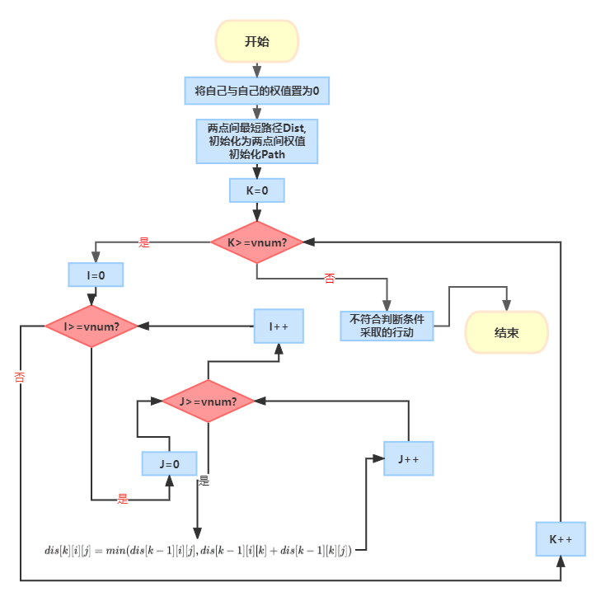
核心算法流程图
以K做为桥梁，放在最外层
i，j双重循环，遍历所有的点对，放在内层

Slide 13

为什么把K放在最外层？
//弗洛伊德算法
for(int k=1;k<=G->vnum;k++){
for(int i=1;i<=G->vnum;i++){
for(int j=1;j<=G->vnum;j++){
if(dist[i][j]>(dist[i][k]+dist[k][j])){
path[i][j]=path[i][k];
dist[i][j]=dist[i][k]+dist[k][j];
}
}
}
}
根据动态规划方程，dist[k][i][j]状态更新只与[k]的变化有关，即只与上一层[k-1]有关系，我们需要先遍历隶属于当前层[k]下所有的点对，再去遍历下一层，因此我们要把K放到最外层，才能完成上述操作。
弗洛伊德算法本质上是利用动态规划寻找最短路径，通过不断的计算局部最优解，并以已知的局部最优解为基础，继续推算新的局部最优解，进而达成全局最优解。
此外，如果将K放在内层，在第一循环时，节点代号为1的节点与其他点的权值就不再发生变化了，对于此权只是局部最优解，并不是全局的最优解。

Slide 14
Dist[i][j] | 门(1) | 二教(2) | 操场(3) | 一教(4) | 三教(5) | 教工(6) | 一食堂(7) | 二食堂(8) | 三(9) | 七(10) | 九(11)
门(1) | 0 | 40 | 100 | 140 | 190 | 110 | 110 | 120 | 190 | 50 | 30
二教(2) | 40 | 0 | 60 | 100 | 150 | 70 | 85 | 80 | 150 | 70 | 50
操场(3) | 100 | 60 | 0 | 40 | 90 | 120 | 135 | 130 | 100 | 130 | 110
一教(4) | 140 | 100 | 40 | 0 | 50 | 80 | 95 | 90 | 60 | 155 | 150
三教(5) | 190 | 150 | 90 | 50 | 0 | 90 | 90 | 80 | 10 | 150 | 170
教工(6) | 110 | 70 | 120 | 80 | 90 | 0 | 15 | 10 | 80 | 75 | 95
一食堂(7) | 110 | 85 | 135 | 95 | 90 | 15 | 0 | 10 | 80 | 60 | 80
二食堂(8) | 120 | 80 | 130 | 90 | 80 | 10 | 10 | 0 | 70 | 70 | 90
三(9) | 190 | 150 | 100 | 60 | 10 | 80 | 80 | 70 | 0 | 140 | 160
七(10) | 50 | 70 | 130 | 155 | 150 | 75 | 60 | 70 | 140 | 0 | 20
九(11) | 30 | 50 | 110 | 150 | 170 | 95 | 80 | 90 | 160 | 20 | 0

Slide 15
Path[i][j] | 门(1) | 二教(2) | 操场(3) | 一教(4) | 三教(5) | 教工(6) | 一食堂(7) | 二食堂(8) | 三(9) | 七(10) | 九(11)
门(1) | 1 | 2 | 2 | 2 | 2 | 2 | 11 | 2 | 2 | 11 | 11
二教(2) | 1 | 2 | 3 | 3 | 3 | 6 | 6 | 6 | 6 | 11 | 11
操场(3) | 2 | 2 | 3 | 4 | 4 | 4 | 4 | 4 | 4 | 2 | 2
一教(4) | 3 | 3 | 3 | 4 | 5 | 6 | 6 | 6 | 5 | 6 | 3
三教(5) | 4 | 4 | 4 | 4 | 5 | 9 | 9 | 9 | 9 | 9 | 9
教工(6) | 2 | 2 | 4 | 4 | 8 | 6 | 6 | 8 | 8 | 7 | 7
一食堂(7) | 10 | 6 | 6 | 6 | 8 | 6 | 6 | 8 | 8 | 10 | 10
二食堂(8) | 6 | 6 | 6 | 6 | 9 | 6 | 6 | 8 | 9 | 7 | 7
三(9) | 8 | 8 | 5 | 5 | 5 | 8 | 8 | 8 | 9 | 8 | 8
七(10) | 11 | 11 | 11 | 7 | 7 | 7 | 7 | 7 | 7 | 10 | 11
九(11) | 1 | 2 | 2 | 2 | 10 | 10 | 10 | 10 | 10 | 10 | 11

